Slide 1

Product Recommendation System: A Deep Dive
This presentation explores the implementation of a product recommendation system. We will focus on content-based filtering to enhance user experience. By leveraging machine learning, our goal is to improve product discovery, boost engagement, and enhance user satisfaction.

Slide 2

Core Objectives & Benefits
1
Improve User Engagement
Increase user satisfaction and interaction with personalized recommendations.
2
Increase Conversion Rates
Boost sales and revenue by suggesting relevant products.
3
Enhance User Experience
Provide a seamless experience via system integration.
4
Reduce Bounce Rates
Decrease bounce rates by encouraging exploration.

Slide 3
Why a Recommendation System?
Reduce Decision Fatigue
Enhance Engagement
Improve Shopping Experience
Filters vast datasets to provide personalized suggestions.
Helps users discover new items efficiently.
Analyzes user behavior to present relevant items.

Slide 4




Hardware Requirements
Intel Core i3+
4GB+ RAM
10GB+ Storage
Efficient computation handling.
Adequate data processing.
Dataset and file storage.

Slide 5
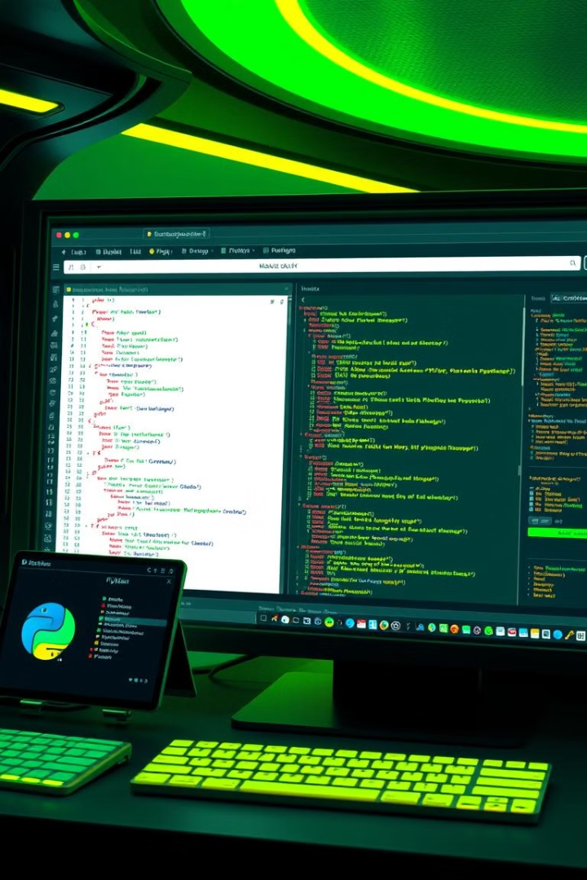



Software Requirements
Operating Systems
Windows, Linux, Mac.
Development Environment
Jupyter Notebook, VS Code.
Python Libraries
Pandas, NumPy, Scikit-Learn, Streamlit app.

Slide 6




Key Technologies Used
Python
1
TF-IDF
Primary language
2
Analyzes descriptions
Streamlit app
4
Cosine Similarity
3
Web interface
Measures similarity

Slide 7
Implementation Example
import pandas as pd
from sklearn.feature_extraction.text import TfidfVectorizer
from sklearn.metrics.pairwise import cosine_similarity
import streamlit as st
# Load dataset
df = pd.read_csv("products.csv")
print("Dataset loaded successfully!")
print(df) # Debug print
# Function to recommend products
def recommend_products(product_name, df, top_n=5):
tfidf = TfidfVectorizer(stop_words='english')
tfidf_matrix = tfidf.fit_transform(df['product_description'])
cosine_sim = cosine_similarity(tfidf_matrix, tfidf_matrix)
indices = pd.Series(df.index, index=df['product_name']).drop_duplicates()
try:
idx = indices[product_name]
except KeyError:
return [] # Product not found
# Get category of the input product
product_category = df.loc[idx, "category"]
# Compute similarity scores
sim_scores = list(enumerate(cosine_sim[idx]))
sim_scores = sorted(sim_scores, key=lambda x: x[1], reverse=True)
# Get product indices and filter by category
product_indices = [i[0] for i in sim_scores if df.iloc[i[0]]["category"] == product_category]
return df['product_name'].iloc[product_indices][:top_n]
# Streamlit app
st.title("Product Recommendation System")
st.write("Enter a product name to get recommendations.")
# Input field for product name
product_name = st.text_input("Product Name:")
# Button to get recommendations
if st.button("Get Recommendations"):
if product_name:
print(f"User entered product: {product_name}") # Debug print
recommendations = recommend_products(product_name, df)
if len(recommendations) == 0:
st.write("No recommendations found. Please try another product.")
else:
st.write("Recommended Products:")
for product in recommendations:
st.write(f"- {product}")
else:
st.write("Please enter a product name.")

Slide 8

Testing & Results
Valid Input
Invalid Input
Returns similar products.
Displays "Product not found".
Empty Input
Prompts for valid input.

Slide 9

Future Enhancements
1
Hybrid Filtering
Combine content-based and collaborative filtering.
2
Deep Learning
Enhance accuracy with neural networks.
3
Cloud Deployment
Ensure scalability and accessibility.

Slide 10

Github Repository

Slide 11



Done By
Mohammed Haris Uddin
Khaja Rahber Uddin
Syed Safwan Waseem

